Slide 1
KS2 Mathematics
Notes:
Welcome etc

Slide 2
What do we want children to be able to do with their maths?
Become fluent in the maths basic skills, to recall and apply number facts rapidly and accurately
Be able to reason, generalise, and prove their ideas
Solve problems, applying their maths to unfamiliar contexts and persevere to find solutions.
Notes:
These three statements are paraphrased from the NC. Much greater emphasis on problem solving than before, supported by fluency in the basic skills: counting, number bonds, times tables and place value. You might have heard of ‘Mastery Maths’: we say that chn have mastered a concept when they can apply it to a totally new problem in an unfamiliar situation. This is key to them being able to use their maths in skills in real life situations.

Slide 3
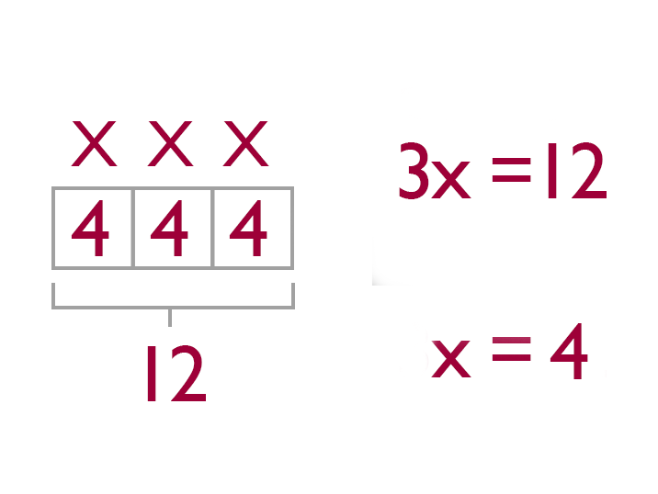
What are the main areas of KS2 maths?
Number:
Place value
Addition and subtraction
Multiplication and division
Fractions
Measurement
Geometry
Statistics
Additionally, in Year 6:
Ratio and proportion
Algebra
Notes:
Until Y6 there are 4 main areas of maths – number being the widest and most important, the remaining applying those number skills to other mathematical problems. By this point in the year, we have just about finished the number section! In Y6 we extend multiplicative reasoning to ratio and proportion (which are very important in KS3 and 4) and also introduce simple algebra.

Slide 4
Our approach to teaching (Year 5 example)
Teach topics in their entirety,
spending long ‘chunks’ of time on each , before moving on.
Children need secure
understanding of every
concept.
Extension through depth
achieved by challenging
pupils with reasoning
challenges.
Notes:
As you can see in this example from Y5, we spend most of the year on number! This approach to teaching gives children total immersion in each topic over a number of weeks, deepening their understanding of the concepts involved. Our aim is that all the children can understand and use these concepts; we aim for depth, not breadth of understanding.

Slide 5
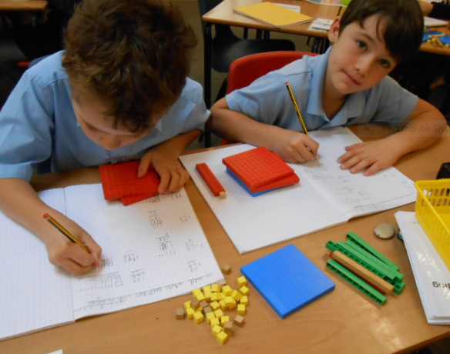
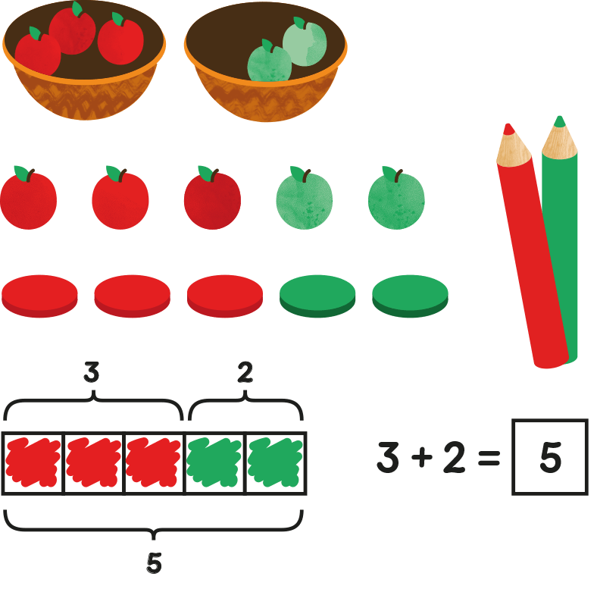
Concrete, pictorial, abstract progression
Children are introduced to ideas through the use of manipulatives.
They learn to represent their ideas as pictures / jottings.
They then move into the abstract.
Children move through these stages
at different rates.
Notes:
The CPA model describes how chn learn through exploring their maths physically, then represent their ideas on paper. Eventually they can reason using just numbers and we say they are working in the abstract. Some chn need to spend longer with apparatus (or fingers) than others, some rely on dots and circles longer than others. Our aim is that they can all eventually move into the abstract.

Slide 6
What does a maths lesson look like?
Fluency practice: times tables, counting (in intervals), mental calculations and strategies.
Main teaching: the teacher explains and models the new concept, leading the class through a series of short activities to scaffold their learning.
Independent or group activities: children work autonomously to explore the new concept themselves. They may work with apparatus, draw diagrams, or complete written calculations, depending on what stage they are at in their learning.
Reasoning / problem solving application.
Notes:
There’s no such thing as a model maths lesson – every teacher adapts their teaching to suit their pupils – but this is what a typical lesson might look like, if you popped in to watch.

Slide 7
What if my child doesn’t understand?
The teacher will carefully observe the children and offer support or adapt activities as needed.
If further help is needed, they may receive extra support in a small group or individually, possibly after the lesson.
We don’t want anyone to be left behind!

Slide 8
What happens if my child finds the task easy?
Some children grasp mathematical concepts rapidly.
Once they have demonstrated a secure understanding, they will be challenged to apply their knowledge to a reasoning problem.
Notes:
Have a go at the problem on the A3 sheets – please work together and discuss (it’s a really important part of maths). I won’t pick on anyone to answer, but if you’d like to explain, you’d be very welcome!

Slide 9
Key concept 1: Commutativity
Addition
We know that 2+3 = 3+2
Order doesn’t matter
We can count on from the larger number rather than from the smaller number.
Multiplication
Again, order doesn’t matter.
You only need to half of your times tables ☺
Subtraction
3-2 = 1 but 2-3 = -1
Order does matter
Support this by using real life examples (e.g.money)
You CAN subtract a larger number from a smaller, but it depends on context (e.g. temperatures)
Division
We need to make sure we have the correct devisor.
Notes:
There are a couple of ‘key concepts’ that are important cornerstones of KS2 maths. Unless you are a maths whizz you might not have used these words, so I’ll explain, however, you will be very used to the concepts themselves.

Slide 10
Key Concept 2: Exchange
This used to be called ‘carrying’ or ‘borrowing’!
We can look at this with rods and cubes.
The ‘concrete’ stage is really important in building understanding.
TN: 23 – 7, 13 cubes, 2 tens each
Notes:
Let’s have a go using the rods and cubes. A rod = 10 and a cube = 1. Make 23. We want to subtract 7. What do we need to do? We EXCHANGE a rod for 10 cubes so we have only 1 rod left and 13 cubes.

Slide 11
Useful strategies
1. Partitioning
Splitting a number into ones, tens and hundreds
156 = 100 + 50 + 6
24 + 15 = 20 + 4 + 10 + 5
= 20 + 10 + 4 + 5
TN: demo with PV counters
Notes:
Your child might mention partitioning, so this is what it means.

Slide 12
2. Compensation
When adding a number close to a multiple of 10 (or 100), it’s easier to add the multiple of 10 and then adjust the total.
23 + 9 = 23 + 10 -1
Support with a number line – jump on 10, step back 1. +10 -1
_______________________________________
23 32 33
Notes:
This is brilliant trick to help your child with mental maths. Numberlines are easy to draw and easy to imagine.

Slide 13
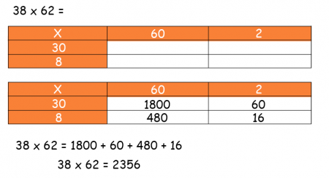
Grid method:
On wbs?
Notes:
This is often one that comes up at parents evening! It’s taught primarily in Y3 and 4 as an introduction to formal multiplication. I recap it in Y5 as we move onto long multiplication as it makes the process easy to understand. Let’s have a go…We partition each number into tens and ones, then multiply each. At the end, we add the products to get our answer.

Slide 14
How are children assessed in mathematics?
Children’s learning is constantly monitored in the classroom, to enable timely support to be given.
Half-termly tests are carried out to formally assess progress, so any children needing additional support can be identified.
Annual testing is carried out in May and these results, along with teacher assessment, are reported to you in reports.
In May of Year 6, children sit national tests (SATs) to assess whether they are at the expected standard. Some children will be below this standard, others will exceed it.

Slide 15
What is the ‘expected’ standard at the end of Year 6?
In May, Year 6 children sit an arithmetic paper, followed by two reasoning papers.
Calculators aren’t allowed!
Some SATs questions are available to have a go at!
Notes:
Have a look at the SATs questions in the tables. Have a go – I won’t pick on anyone for answers!
What did you think? Did anything surprise you?

Slide 16
KS2 to KS3 and 4 (GCSEs)
Much of the maths that your child will need in KS4 is actually taught in KS2.
The foundations of all their future learning are laid.
For example, no new fraction work is covered until Year 9!
That’s why it is so important that your child is confident with their maths at the end of primary school.

Slide 17
Notes:
To illustrate this, here are two questions from exam papers, in fact from KS2 SATs (Y6) and the foundation paper GCSE (Y11). Which one is which? The only ‘tweaking’ has been in presentation (pictures removed etc), not content.

Slide 20
How can you support your child’s learning in mathematics?
Encourage them to learn their times tables.
Practise basic number bonds and mental calculations.
Ask them to calculate change when shopping.
Teach them to tell the time on analogue and digital clocks.
Ask them to help you read timetables.
Can they tell you how long a TV programme will last?
Can they calculate how many sweets each child will have, when sharing?
Bring maths into everyday life, so they can see the relevance of it.
Explain the maths you are doing when cooking, working, playing sport.

Slide 21
Most of all – be positive!
You are your child’s greatest role model.
If you are positive and enthusiastic about maths, they will be too.
Image by Trainugly.com

