Slide 1

KS2 English at
Cranwell Primary School

Slide 2
What is the KS2 English Curriculum composed of?
- Reading – decoding and comprehension;
- Writing – composition, vocabulary, spelling,
punctuation and grammar, handwriting and
presentation;
- Speaking and Listening.

Slide 3
What is expected of our children by the time they reach May of Year Six?
Statutory Assessment Tests (SATs) take place in May of Year Six.
Children take tests in:
- Reading
- Spelling
- Punctuation & Grammar.
These tests are marked externally and the results reported back to schools and then parents (& children) in July.
Children nationally are expected to reach the ‘expected standard’. Particularly able children will achieve ‘greater depth within the expected standard’. Some children may find this ‘expected standard’ too challenging and will be judged as ‘Working towards the expected standard’.

Slide 4
What is expected of our children by the time they reach May of Year Six?
Teachers are required to provide ‘Teacher Assessment’ in writing, based upon a child’s work.
Children nationally are expected to reach the ‘expected standard’.
Particularly able children will achieve ‘greater depth within the expected standard’.
Some children may find this ‘expected standard’ too challenging and will be judged as ‘Working towards the expected standard’.

Slide 5
So… what does the ‘expected standard’ look like in writing?
Please have a look at ‘Our trip to the Globe’ in your handout – just a few minutes to read it and then we can highlight some of the reasons why this writing is at the ‘expected standard’.
Notes:
Look at exemplification example – talk through the positive points – LINKED to TA framework ‘Pupil Can’ statements.
Emphasise that this is only ONE piece – ch need to write at this standard across a range of pieces, covering a range of genres. This collection demonstrates that the pupil is consistently and confidently able to produce writing that meets all of the statements for ‘working at the expected standard’ across a broad range of tasks, each of which is effectively adapted for purpose and audience.

Slide 6
Government Exemplification Materials:
Our trip to the Globe
Even though the journey was long, it was definetely worth it, because last Friday, I had an interesting day learning new things about William Shakespeare, and the Globe theartre – which is where Shakespeare’s plays are shown.
To begin the day with a thrill, I was able to go into the Globe Theartre and feel what it was like sitting in the different seats (which depended on your status, meaning how wealthy you are). Standing where the poorest people would go, made me feel small and diminutive but sadly if you were a poor person you would be called a ‘penny stinker’. However they were able to see what no one else was able to see; it was a beautiful detailed painting with a drawing of the sun. And no, it was not just any drawing of the sun it was one with doors that led to heaven. Are you still doubting being a penny stinker?
Notes:
Spelling and punctuation errors, etc. – text copied directly as it was written by the child.

Slide 7
As the day carried on, our tour guide (Olivia) led us into a room where we had an acting workshop and as we walked to the room, on the walls was a quote from one of Shakespeares plays ‘to be or not to be’ in a wide range of languages (although I only understood the quote in English). Anyway, lets get back to talking about the workshop. As any normal actor would do, mu class (yr 6), were told by Olivia to warm up. However, we had to clap and stomp at the same time but the only communication we were allowed to use was eye contact, which is quite difficult in my opinion. Eventually we were able to do it, so we finally moved onto the proper acting activity. Olivia, gave four people a peice of paper and split the class into two equal sections. My group was called Montagues (which is Romeo’s family name) and the other group was called the Capulets (which is Juliets family name). Do you know which one of Shakespeare’s plays I was talking about? Yes! I was obviously talking about the play Romeo and Juliet. Fortunately, I was chosen to read out one of the scripts and I played Benvolio who is a kind and caring man who only wants peace in life. Over all I would rate the day as 10 out of 10 because I learnt so many new and amazing facts. Also, from great experience of being in the Globe theartre, I would definetly like to come and watch a play there! Would you like to visit the Globe theartre?
Notes:
Ben – vo – li – o - pronunciation

Slide 8
Just after we had finished our lunch, we took an interesting stroll through London. Whilst we were walking I came across a dirty skeleton in a cage in public view (this was because Clink Prison is the oldest prison in London)! In my opinion, it was really unexpected and shocking to see such a horrifying object in a local busy street. Not only did we get to see Clink Prison, but year 5 and 6 were also lucky to view the Golden Hinde which is a boat that is 31m on deck. Surprisingly, I didn’t know anything about this so one of my lovely teachers (Mrs. XXX) asked us all to find out some facts at the weekend.
I can’t believe the amount of fun I’ve had discovering so many interesting facts and co-operating together when acting.

Slide 9
What makes this piece of writing the ‘expected standard’?
COMPOSITION:
This informal account of a school outing interweaves specific memories of the day with factual information and comments from the writer that show a good awareness of the reader.
Following a brief introduction, a series of chronologically-organised paragraphs details selected activities.
The pupil communicates a sense of enthusiasm, sharing comment and opinion through apt choices of vocabulary and informal structures which enable the reader to share in the experiences of the day.
A range of cohesive devices are used effectively and correctly, including adverbials to establish time frames , repetition for emphasis and pronouns.
Use of a question to draw in the reader.
The conclusion draws together the themes effectively: that it was both fun and full of facts. This helps to establish further a sense of cohesion across the piece.
Notes:
Apt vocab choices – definitely worth it; a thrill; feel small and diminutive; interesting stroll; horrifying object.
Informal structures – Anyway, lets get back to talking; if you were a poor person, you would be called a ‘penny stinker’.
Adverbials to establish time frames – last Friday; as the day carried on.
Repetiton for emphasis – a drawing of the sun… not just any drawing of the sun
Pronouns – I was able, you would be called, they were able, no one else was.

Slide 10
What makes this piece of writing the ‘expected standard’?
GRAMMAR & PUNCTUATION:
- A wide range of clause structures within a single sentence, including subordination.
- Uses a wide range of verb forms for effect, e.g. To begin; standing; would; passive.
- Expanded noun phrases, incorporating preposition phrases, convey and link complex information concisely.
- Brackets for parenthesis, inverted commas, a hyphen, a dash to mark a strong after thought, and a semi-colon to mark the boundary between independent clauses, are all used correctly.
- Commas are used for clarity with only occasional errors.
- There are some omissions of apostrophes for contraction and possession.

Slide 11
What makes this piece of writing the ‘expected standard’?
- Spelling is mostly correct.
- The joined handwriting is legible.

Slide 12
Although she shows some evidence of working ‘at greater depth within the expected standard’, she does not yet show ‘the assured and conscious control over levels of formality’ that would be expected of a pupil working at greater depth.

Slide 13
How do we support the children to reach this ‘expected standard’?
A stimulus
Talking/discussion
Using drama to help the children ‘get into character’ and empathise.
Developing and extending the vocabulary knowledge linked to a topic.
Reading similar texts that will support their writing, providing them with a good ‘model’ to emulate.
Identifying the key features of the key text type.
Planning using a planning template specific to each specific task.
Writing.
Editing.
Producing a final published piece.
Notes:
Stimulus – image, music, film excerpt, poem, book, cross-curricular?
With peers, groups and as a class.
Editing – with peers, self-editing, use of a dictionary.
Published piece – by hand or on computer. A selection.
Not all pieces of work will have every single stage BUT they will have the majority of them.

Slide 14
Any questions about the writing expectations?

Slide 15
So… what does the ‘expected standard’ look like in reading?

Slide 16
https://www.youtube.com/watch?v=O4KJZ1oSkbI
Working at the expected standard – KS2 Reading. The Boy in the Striped Pyjamas.
Notes:
The pupil can: - read age-appropriate book with confidence and fluency (including whole novels)
- read aloud with intonation that shows understanding

Slide 17
Albion’s Dream – Have a read through.
Notes:
This is one of three texts from last year’s (2018’s) reading SATs paper.

Slide 18
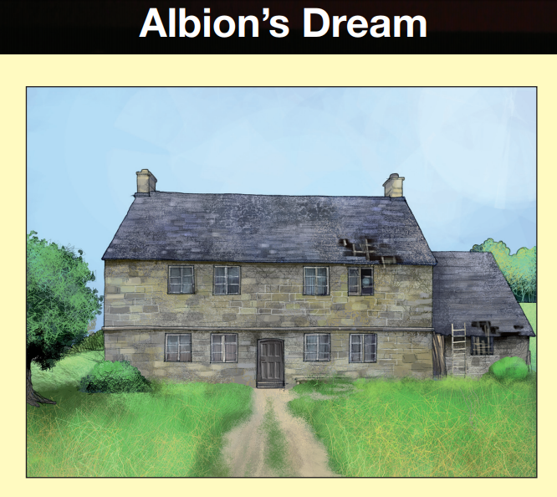
From 2018 Y6 SATs Reading Paper.

Slide 19
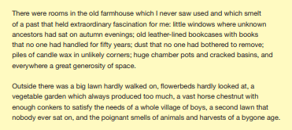

Slide 20
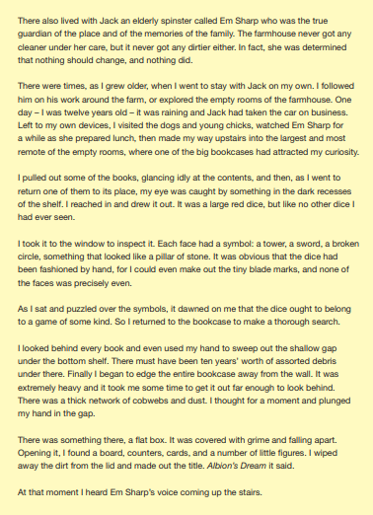

Slide 21
Strong emphasis on:
Give / explain the meaning of words in context
Notes:
This is from the 2018 SATs paper – the pass mark was 28/50 for the expected standard & 40/50 for working at greater depth within the expected standard.

Slide 22
Look at the second paragraph on page 9.
Left to my own devices...
This means that Edward... Tick one. (1 mark)
- had lost something.
- was confident with equipment.
- had a good imagination.
- was free to do what he wanted.

Slide 23
...it dawned on me that the dice ought to belong to a game...
Which of the following is closest in meaning to dawned on me as it is used here? Tick one. (1 mark)
- began to worry me
- became clear to me
- made me feel better
- puzzled me

Slide 24
Strong emphasis on -
Make inferences from the text / explain and justify inferences with evidence from the text.

Slide 25
Look at the first paragraph.
What suggests that the inside of the old farmhouse was not very well looked after? Give two things. (1 mark)
1.
2.

Slide 26
Look at page 10.
What impressions do you get of Em Sharp at this point in the extract?
Give two impressions, using evidence from the text to support your answer. (3 marks)
Impression | Evidence

Slide 27
How do we support the children to reach this ‘expected standard’?
- Whole class comprehension activities;
- Small group reading activities;
- Individual reading independently and with an adult’s support.
Through discussion and then encouraging the children to record their answers in writing.

Slide 28
Any questions about the reading expectations?

Slide 29
Finally… what does the ‘expected standard’ look like for the Spelling, Punctuation & Grammar element (SPAG)?

Slide 30
There are seven key foci in the SPAG test: (Questions taken from 2018 Y6 SPAG Test).
Grammatical Terms/ Word Classes
Underline the adverbial in the sentence below. (1 mark)
On Wednesday, Felix has a dental appointment
Notes:
This is a focus which has one of the biggest allocation of marks across the paper.
‘On Wednesday’.

Slide 31
Functions of Sentences.
Tick one box in each row to show whether the sentence is a question, command or statement. (1 mark)
Sentence | Question | Statement | Command
In autumn, many trees lose their leaves
Look at the trees carefully
Scientists are studying how trees can live for thousands of years
How can you tell a tree’s age

Slide 32
3. Combining words, phrases and clauses.
Underline the subordinate clause in the sentence below. (1 mark)
Hassan and I are going to our dance class; we are going to be late as we missed the bus.
Notes:
As we missed the bus.

Slide 33
4. Verb forms, tenses and consistency.
Explain how the modal verb changes the meaning of the second sentence. (1 mark)
Yusuf and his sister go swimming
with their dad.
Yusuf and his sister might go
swimming with their dad.

Slide 34
5. Punctuation – again a significant number of marks are linked to this.
Rewrite the sentence below as direct speech.
Remember to punctuate your sentence correctly. (1 mark)
I asked her if she needed any help.
I asked, ______________________________
Notes:
I asked, “Do you….?”
CAPITAL letter to start the speech – as it’s the start of the sentence for the quote.

Slide 35
6. Vocabulary
Add a suffix to the words in the boxes to complete the sentences.
Our school believes in _________for all pupils.
e
We took ____________clothing in case it turned cold.
addition
equal
addition

Slide 36
7. Standard English and formality
Which sentence is written in Standard English? Tick one.
Two sports teams come to our school yesterday.
My friend was tidying the classroom.
Today the children done their school play.
The teachers was going to send a letter next week.

Slide 37
Spellings – these are the words from last year’s SATs paper:
Thumb
Trouble
Mixture
Portable
Dough
Science
Attention
Obtained
Weightless
Council
Suffered
Typical
Usually
Cautious
Essential
Vague
Adventurous
Architect
Descendant
Inconceivable
Notes:
Ch are untimed for this. Told the word, then re-told as part of a sentence and then the word is repeated again.
Ch obviously have to write very carefully so that we can clearly see the spelling of the word.

Slide 38
How do we support the children to reach this ‘expected standard’?
Regular lessons on the key elements of Punctuation & Grammar, usually specifically linked to a text type/genre, for example, discussing imperative verb forms when writing instructions.
Daily spelling lessons following our Read, Write, Spell Inc. programme.
Additional activities to support those children who find spelling more challenging.
Children are encouraged to use dictionaries and ACE spelling dictionaries.
Three spellings in most pieces of work are corrected and the child is asked to re-write, as part of following up on their marking feedback.

Slide 39
Any questions about the SPAG expectations?

