Slide 1
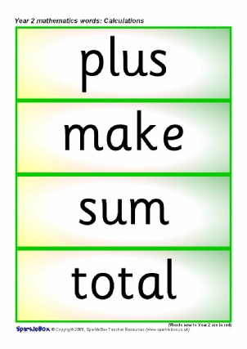
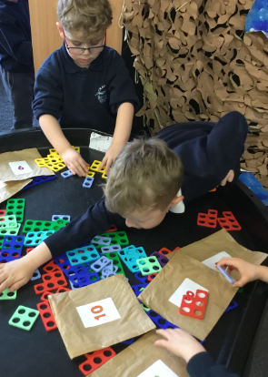
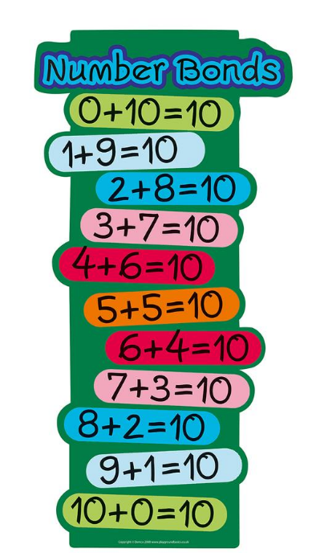
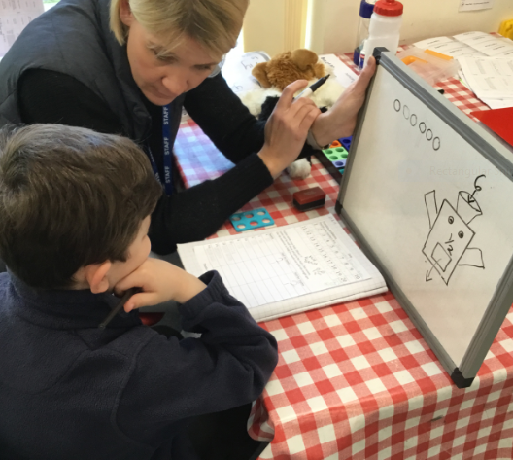
Maths in KS1
Notes:
Welcome etc. We’ll be looking this evening at the learning that takes place as your child leaves the Foundation Stage and moves into Years 1 and 2, what they expectations are at the end of KS1 and how you can help to support them on this important stage of their journey.

Slide 2
What do we want children to be able to do with their maths?
Become fluent in the maths basic skills, to recall and apply number facts rapidly and accurately
Be able to reason, generalise, and prove their ideas
Solve problems, applying their maths to unfamiliar contexts and persevere to find solutions.
Notes:
These three statements are paraphrased from the NC. Much greater emphasis on problem solving than before, supported by fluency in the basic skills: counting, number bonds, times tables and place value. You might have heard of ‘Mastery Maths’: we say that chn have mastered a concept when they can apply it to a totally new problem in an unfamiliar situation. This is key to them being able to use their maths in skills in real life situations.

Slide 3
What are the main areas of KS1 maths?
Number:
Place value
Addition and subtraction
Multiplication and division
Fractions
Measurement
Geometry
Statistics (Y2)
The main focus:
Develop confidence and mental fluency with whole numbers, counting and place value.
Involves working with numerals, words and four operations.
Practical resources are vital – you have a selection to explore!
Notes:
Just as in KS2 there are 4 main areas of maths to explore, although statistics (tally charts , diagrams and tables) is only introduced in Y2. The majority of the year is spent working on Number, as this is by far the greatest part of the curriculum and the aspect on which all the others rest.

Slide 4
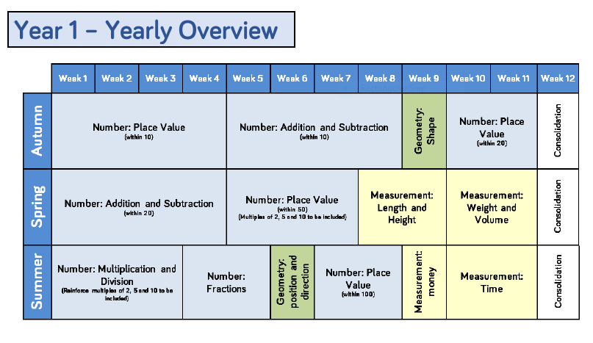
An example of our plan for Year 1

Slide 5
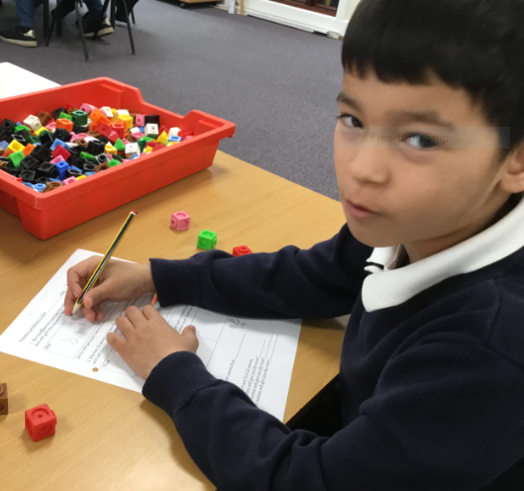
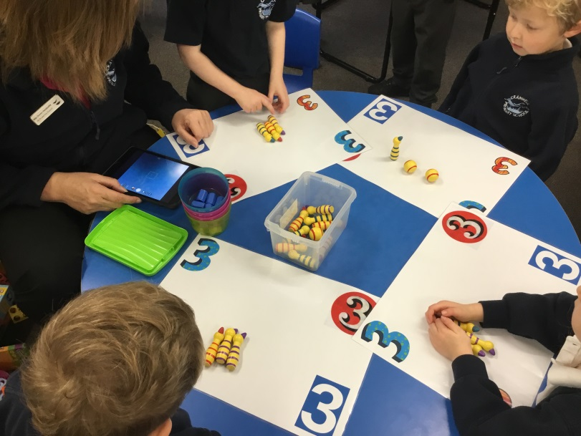
Concrete, Pictorial, Abstract
Concrete
Children begin exploring concepts using objects, such as counters, sticks, Numicon or real-life items.
Notes:
When a child first encounters a mathematical concept, it will be presented in a practical way, using apparatus, such as you have om your tables.

Slide 6
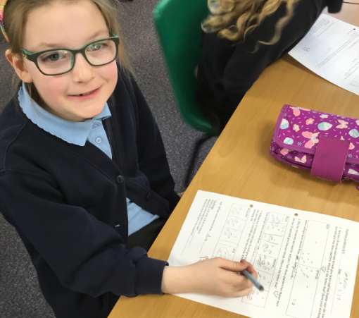
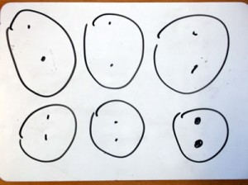
Pictorial
They move on to
representing the objects as pictures.
Notes:
Over time, they start to represent the apparatus as pictures.

Slide 7
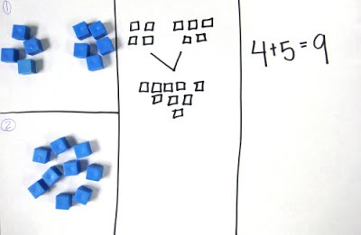
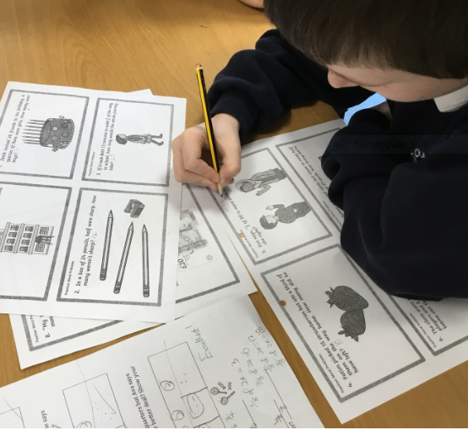
Abstract
Finally, they represent their ideas in abstract ways, using numerals and mathematical symbols (+-÷x=)
Notes:
Children move through this progression at different rates – some need more time with apparatus than others. We are looking for a secure understanding of the concepts, so it’s important not to rush. If you’re helping your child at home, don’t worry if they need objects to count – my own children used pieces of dry pasta (counting pasta) during KS1 and even into Y3. If it supports their understanding, go with it.

Slide 8
What does my child do in a maths lesson?
Fluency practise – counting up and down, number bonds etc.
Introduced to new learning practically, through carefully scaffolded activities.
Independent, guided or group work. Groups of children may rotate around a variety of exercises throughout the week.
Reasoning challenges, when they are ready.
Notes:
There’s no such thing as ‘typical’ maths lesson, but most will include most of these activities. Children who need extra help will be quickly identified and offered support. Those who progress more rapidly will be challenged with problems to solve.

Slide 9
The importance of language
For children to express their mathematical ideas and solve problems they need the correct vocabulary.
6 + 5 = 11 is a sum (the word ‘sum’ means total)
6 – 5 =1 is a subtraction
We often use the term ‘number sentence’ to mean a calculation involving numerals and operators.
Digits are 0-9, the ‘alphabet’ of numbers.
Notes:
Language is vital to our learning: as we reason, we ‘talk to ourselves’. We need to give chn the vocabulary to express their maths. Discussing your child’s reasoning with them is a great way to do this. Ask them to teach you how to do something, to explain how the know an answer is right etc.

Slide 10
Addition and subtraction
(Inverse operations)
First encountered by physically combining or removing groups of objects, practising using the vocabulary more, less, total, makes, and, add, take away, left over…
Children then progress to drawing diagrams, and then to writing number sentences.
Number bonds to 10
Number bonds to 20
Notes:
So, looking in more detail at the number work your child will be doing…
Children are expected to be confident in working with numbers to at least 20 by the end of Y2 – not just counting to 20, but adding, subtracting x an dividing numbers up to 20.

Slide 11
Key concept 1: Commutativity
Addition
We know that 2+3 = 3+2
Order doesn’t matter
We can count on from the larger number.
Subtraction
3-2 = 1 but 2-3 = -1
Order does matter
Support this by using real life examples
You CAN subtract a larger number from a smaller, but it depends on context (e.g. temp, KS2!)
Notes:
While we’re looking at + and -, we can explore the concept of commutativity. Unless you’re a maths whizz, you might not have heard of it, but you use it every day!

Slide 12
Useful strategies
1. Partitioning
Splitting a number into ones, tens and hundreds
156 = 100 + 50 + 6
24 + 15 = 20 + 4 + 10 + 5
= 20 + 10 + 4 + 5
TN: demo with base 10
Notes:
Partitioning is an other odd maths word that your child might use in connection with + and -.

Slide 13
2. Number lines
Blank number lines can help support addition and subtraction, either counting in ones (early) or alongside partitioning (later).
Helpful in subtraction by counting on (up) from the lower number to the greater. Counting up is easier than counting backwards!
Notes:
These are fabulous for + and -, in fact I use them in Y5 and 6 too. Easy to draw and to visualise.

Slide 14
TN: demo bead string
3. Bridging through 10
Bead strings are particularly good at showing this.
The aim is to partition a number to make 10.
8 + 5 = ?
Number bonds tell us that 8 + 2 = 10 and we have 3 left over.
10 + 3 = 13 _____+2___________+3________
8 10 13
Notes:
Have a look at bead strings

Slide 15
4. Compensation
When adding a number close to a multiple of 10 (or 100), it’s easier to add the multiple of 10 and then adjust the total.
23 + 9 = 23 + 10 -1
Support with a number line – jump on 10, step back 1. +10 -1
_______________________________________
23 32 33
Notes:
Another shout out for number lines. This is a great method to help your child with mental calculations.

Slide 16
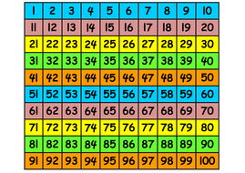
TN: demo 100 sq
5. Hundred squares
Reinforce counting, place value and recognition of patterns.
Notes:
These look a bit old fashioned but they are great for finding patterns and really reinforce place value – add 10, go down a row etc. Also good for times tables.

Slide 17
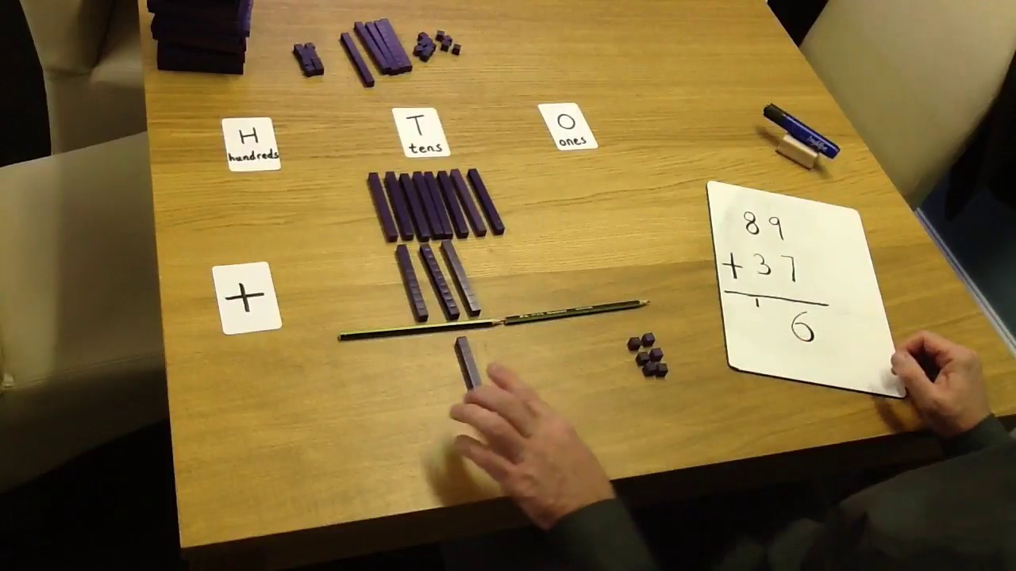
Key Concept 2: Exchange
This used to be called ‘carrying’ or ‘borrowing’!
We can look at this with rods and cubes.
The ‘concrete’ stage is really important in building understanding.
Notes:
23 + 18. Take 4 rods and 11 cubes. Make the two numbers. Now combine them. How many ones do you have? Can we have 11 in the ones column? What is greatest digit we can have? What do you need to do? We EXCHANGE 10 ones for a 10 rod. We now have 4 tens and 1 one = 41. In subtraction we don’t borrow as we never pay it back!

Slide 18
Multiplication and Division
(Inverse Operations)
Children often encounter division as ‘sharing’ objects (toys, sweets etc).
Multiplication is explored as equal groups of items.
Again, we follow the CPA approach, with children moving onto drawing and then to writing number sentences.
Vocabulary is reinforced: share, lots of, altogether, times, divide.

Slide 19
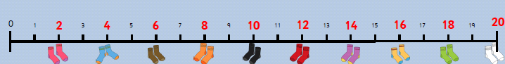
Useful strategies
Counting in intervals
Children begin to count in intervals of 2, 5 and 10. Number lines are really useful here, as are fingers!
Notes:
This eventually becomes times tables

Slide 20
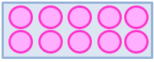
Repeated addition:
2 x 5 = 2 + 2 + 2 + 2 + 2 (5 lots of 2)
This leads to the use of arrays of counters…
which help children to understand commutativity in multiplication.
2 x 5 = 10 5 x 2 = 10
Division is not commutative as 6 ÷ 2 ≠ 2 ÷ 6
Notes:
This is how most chn initially think of x

Slide 21
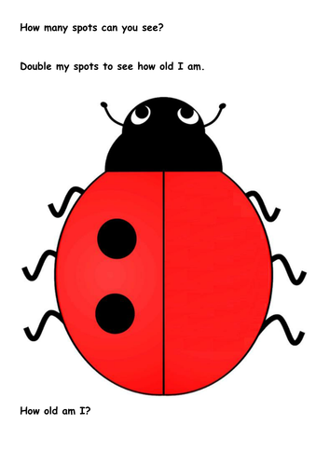
Doubling and halving
Simple division, but also the first step in understanding fractions!
Partitioning into tens and ones can be used:
Double 15 = double 10 + double 5
Notes:
An introduction to fractions!

Slide 22
Missing numbers
Children learn to not always expect the answer at the end:
6 ÷ 2 = ? 6 ÷ ? = 3 ? ÷ 2 = 3
They might be asked to find all the possibilities:
? ÷ = 3
Notes:
Early algebra!

Slide 23
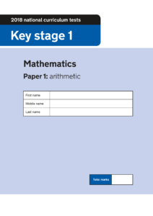

What is the expected standard of maths at the end of Year 2?
Children are assessed by their teacher, using arithmetic and reasoning tests, along with assessments of their everyday work in class.
This information is used to identify and address any problems as they move up into Year 3.
They also allow teachers to see how your child is performing against national ‘expected standards’.
Notes:
Please have a look at the test papers on your tables. Does anything surprise you? Miss Clark is here to answer any questions about the tests as she’s the expert in KS1.

Slide 24
Transition to Year 3
Number bonds to 20.
Partition tens and ones (place value).
Counting forwards and backwards in ones and in intervals.
Times tables : 2x 5x 10x
Real life problem solving – sweets, shopping, how many more?
Discuss the time – analogue clock or watch?
Lots of ‘maths talk’ to support their developing vocabularies. Keep it light-hearted and FUN.
Notes:
Looking towards Y3, what should your child ideally be able to do and how can you support them?

Slide 25
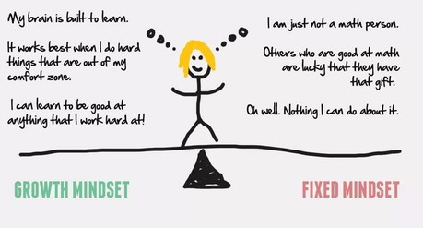
Most of all – be positive!
You are your child’s greatest role model.
If you are positive and enthusiastic about maths, they will be too.
Image by Trainugly.com

